Slide 1
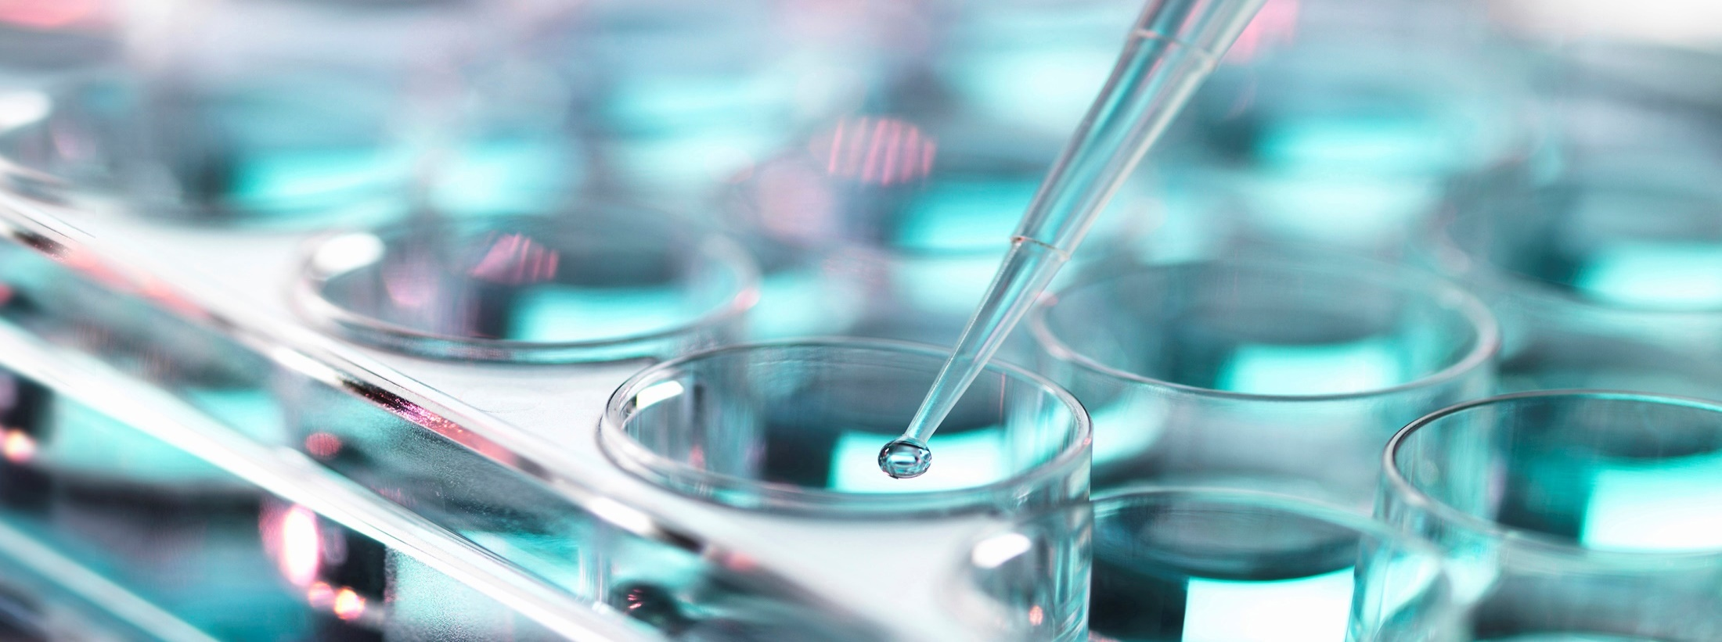
Transfusion Reactions
In vivo behavior versus in vitro reactivity
Paul Aerts December 2019

Slide 2
Transfusion Reactions >< Safety
Immune (antibodies involved)
Haemolytic
Acute
Intravascular
Extravascular
Delayed
Non-haemolytic
Non-immune (no antibodies involved)

Slide 3
Clinical Significance
Blood group antigens on themselves ≠ clinically significant
Blood group antibodies directed against the antigens may be
Clinically significant
Clinically insignificant
Key question
Are the transfused red blood cells destroyed by the antibody
YES ➔ clinically significant capable of causing HTR and/or HDFN
NO ➔ do we need to detect these?
The answer YES/NO is not always straightforward!

Slide 4
Clinical significance and what to do
Specificity | Significant | What to do?
RH (in IAT) | YES | IAT XM antigen neg units
Kell | YES | IAT XM antigen neg units
Duffy | YES | IAT XM antigen neg units
Kidd | YES | IAT XM antigen neg units
Anti-S, -s | YES | IAT XM antigen neg units
Anti-A₁, -P₁, -N | Rarely | IAT XM
Anti-M @ 37°C | Sometimes | IAT XM antigen neg units
Anti-Leª, -Leª+Le^{b} | Rarely | IAT XM
Anti-Le^{b} | NO | IAT XM
HTLA | Unlikely | Refer to reference lab
HIA/LIA | Depends on specificity

Slide 5
Ig Class
The antibodies we are dealing with usually are
IgM
Generally react at lower temperature (<body temperature)
Cannot cross the placenta
! Primary immune response
IgG
Usually clinically significant
React at 37°C
Cross the placenta
4 subclasses
Structural differences
IgG1 ➔ IgG4
Ability to activate complement: IgG3>IgG1>>IgG2>>>>IgG4

Slide 6
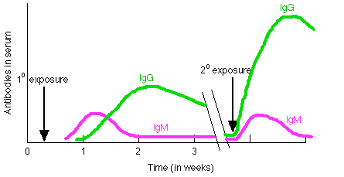
Immune response
Primary
Few days (some weeks) after exposure (e.g. to red cells)
IgM, followed by (low) IgG
Very often  to undetectable
Secondary
Re-exposure to same antigen
Intense and quick response
IgG peak (much) higher
Usually persists (longer)

Slide 7
Traffic Light by blood group system
NOT Black&white ! Some people will disagree on certain antibodies
Usually
Occasionally
Rarely
Based on Anstee D. Blood 2009;114:248-2556

Slide 8
Haemolytic Transfusion Reactions (1)
Acute haemolytic
Immediate, usually during transfusion, <24hrs
Severity depends on
Volume transfused
Nature of antigen (size and location on rbc)
Nature of antibody(ies): IgM or IgG, IgG subtype, concentration, avidity, ability to activate complement
Intravascular (most severe form)
Involves complement activation ➔ hemolysis
Free haemoglobin in plasma  released in urine (Hb-uria)
Bilirubin  ➔ jaundice
Massive complement activation ➔ uncontrollable DIC (death)
Most common cause ➔ ABO errors
Others: anti-H (Bombay), -Jkª, -P,P1,Pk, some -Vel

Slide 9
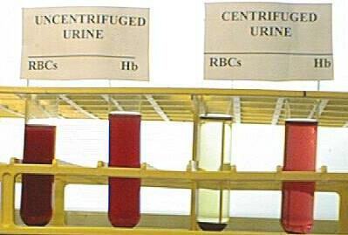
Urine samples

Slide 10
Complement cascade (simple)
Antibody binding
Microbial polysaccharide
C1 C2 C4
Classical Pathway
B D
Alternative Pathway
Cascade often stops here ➔ iC3b, C3d… Separate topic a
Cleavage of C3
C5
C6
C7
C8
C9
Microbes get coated, induction of phagocytosis
Recruitment of inflammatory cells
Cell lysis

Slide 11
Haemolytic Transfusion Reactions (2)
Acute haemolytic
Extravascular
Non complement activating antibodies
Or complement activation stops at C3b level
IgG coated rbc, C3b coated rbc are
Removed from blood circulation in liver and spleen by macrophages (Fc-receptors, Complement receptors CR)
Destruction is slower
Symptoms usually less severe (fever and chills)
Antibodies involved
ABO, Duffy, Kidd

Slide 12
Haemolytic Transfusion Reactions (3)
Delayed haemolytic transfusion reaction (DHTR)
> 24 hrs. up to 14 days after transfusion
Usually between 4-10 days
Antibodies in low concentrations
Sometimes antibodies = undetectable
makes it difficult to prevent
importance of good historical data (e.g. TRIX national database in NL)
Secondary immune response
Usually less severe, occasionally starts as mild but turns into severe
Antibodies usually associated: Rh and Kidd

Slide 13
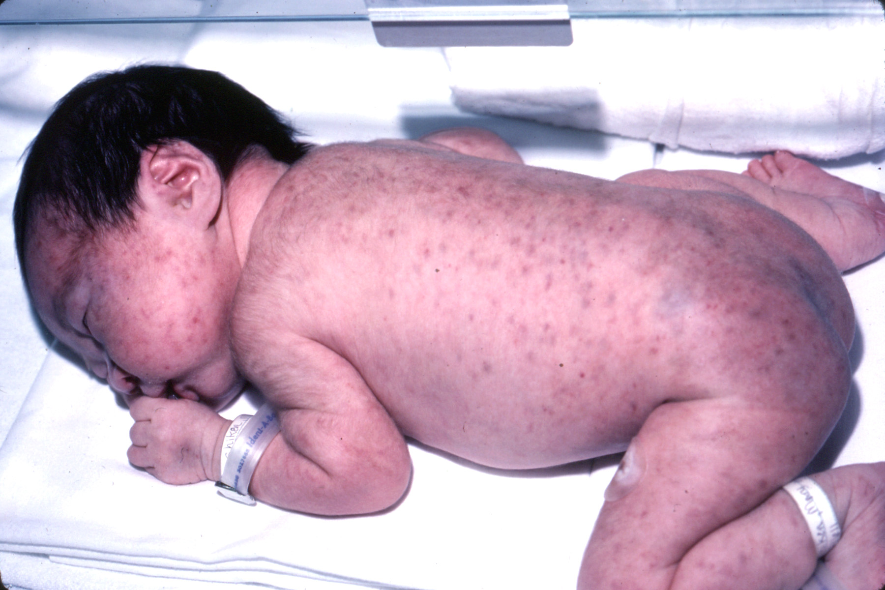
Non-haemolytic Transfusion Reactions (1)
Febrile non-haemolytic ➔ HLA antibodies
Post transfusion purpura➔ platelet antibodies
Allergic reactions ➔ IgE antibodies
Anaphylaxis ➔ anti-IgA in IgA deficient patients
Very severe, patient literally shakes out of the bed
Often lethal when not urgently, properly treated
TRALI (lung injury, ? HLA antibodies)
Graft-versus-host disease (donor T lymphocytes)
Serious, patients usually die within weeks

Slide 14
Non-immune transfusion reactions
NO antibodies involved
Hypothermia (cold blood transfused)
Circulatory overload (too much blood ➔ heart problems
Old blood = high K⁺ concentrations ➔ heart problems
Citrate (anticoagulant used) ➔ heart problems
Transfusion transmitted infectious agents
HIV, HepB, HepC, HTLV, Creutzfeld-Jacob, …..
Bacteria (particularly platelet preparations)

Slide 15
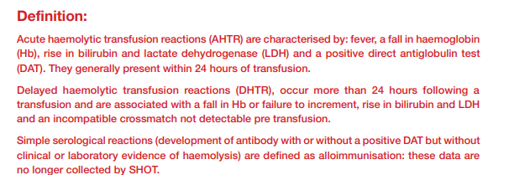
HTR – definitions (from SHOT)

Slide 16
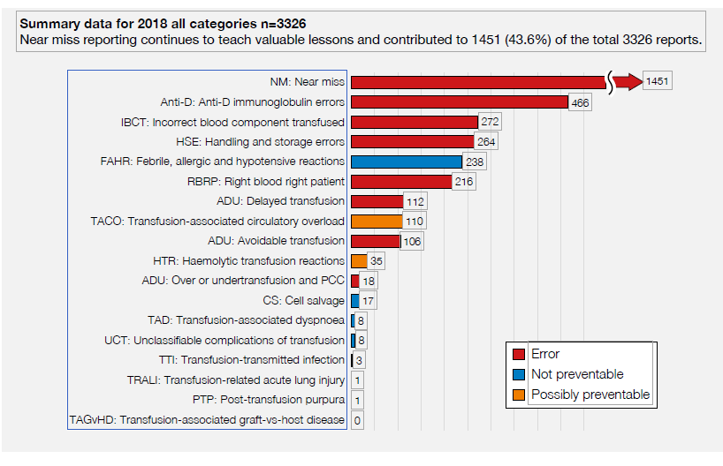
SHOT 2018 report

Slide 17
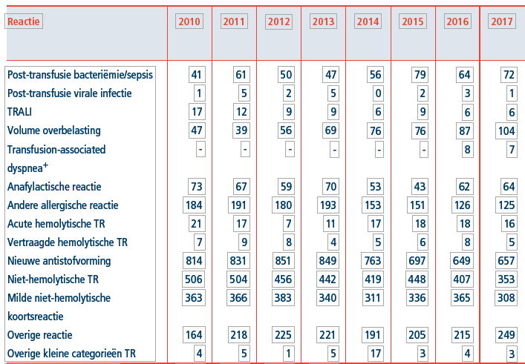
NL TRIP report 2018
Both AHTR and DHTR
Relatively stable
2017 Grade 2 or more
2 → ABO
7 → non-ABO

Slide 18
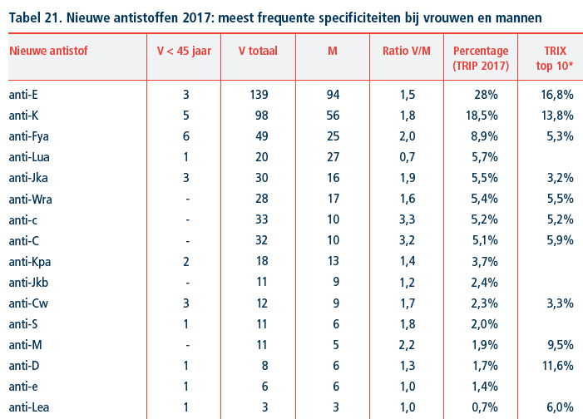
NL TRIP report: newly formed antibodies
Top 10 antibodies

Slide 19
Comparing methods
1184 samples comparing PEG Tube versus SPRCA
 | Number positive samples | Total positive by method | % positive by method | Specificity
PEG + SPRCA - | 14 | 67 | 6% | 2 anti-Leª, 5 false positive, 3 benign autoantibodies
PEG + SPRCA + | 53 |  |  | 4 insignificant, 5 false positive, 7 benign autoantibodies, 37 significant
PEG – SPRCA + | 73 | 126 | 11% | 0 insignificant, 47 false positive, 22 benign autoantibodies, 1 anti-D, -c, -K, - 2 anti-Jkª
Issitt PD. Transfusion 1997;37:288

Slide 20
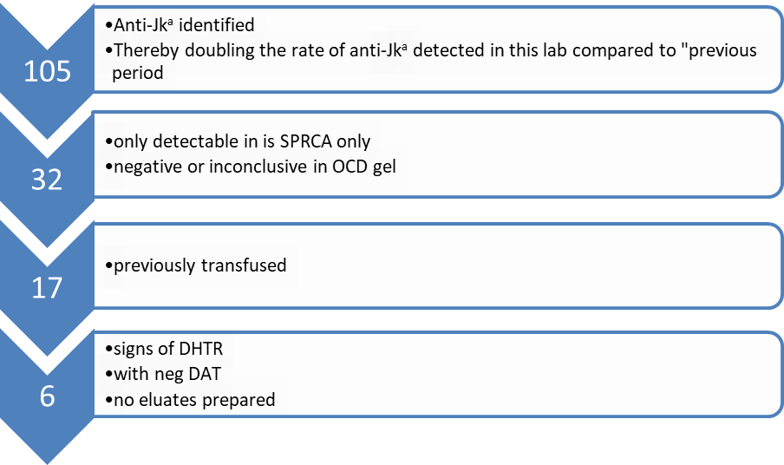
Kay B.Transfusion 2016 Dec;56(12):2973
No attempt to analyze whether these antibodies are newly developed antibodies or stimulation of pre-existing anti-Jkª which would mean that at one point solid phase missed them leading to this DHTR!
Based on the days from the last known transfusion, it is to be believed that some were pre-existing (4 or 5 days).

Slide 21
Choice of a test system
Points to consider
Balance between sensitivity and specificity
Alternative approaches should be available to the lab
Any routine method will produce unique reactivity with no clinical relevance
The consideration that a test is perfect, will give the false sense of security that all significant antibodies will be found → NO

Slide 22
Method dependant antibodies
What are they?
Antibodies found by only one method
All methods have found antibodies falling in this category
Most of these are depending on one or more chemicals present in the test medium
Most are clinically insignificant

Slide 23
Peter Issitt in 2000
“ It is apparent that the next major advance for in vitro testing will be related to predict an antibody‘s in vivo behaviour and not the in vitro sensitivity of the method"
Issitt PD. From kill to overkill: 100 years of (perhaps too much) progress Immunohematol 2000;16:18
We are not there yet!

