Slide 1

Antibody Identification Introduction
Paul Aerts
Scientific Affairs Manager
December 2019

Slide 2
Antibody Identification
Diacell
I-II-III
Antibody Screen positive
DiaPanel & DiaPanel P
Identify antibody (ies)
Phenotype
Select antigen negative donors
Cross match
Crossmatch the selected donors
Safely Transfuse Your Patient

Slide 3
When to do antibody identification?
A positive antibody screening
  Transfusion candidate
  Prenatal
    D neg and D pos
  Donor
A newly formed antibody present?
To confirm a previously identified antibody

Slide 4
Allo- or autoantibody?
Alloantibody
  An antibody against antigens on the red blood cells not present on the patient’s own red blood cells
  E.g. Alloanti-e in a patient who is e neg
Autoantibody
  An antibody against antigens on the red blood cells present on the patient’s own red blood cells
  E.g. Autoanti-e in a patient who is e pos

Slide 5
ID - DiaCell I-II-III specifications
Mandatory fixed Rh combination: DCCee, DccEE and cc.ee
and cell I ➔ C^{w}+
Antigens mandatory present:
K, k, Fyª, Fy^{b}, Jkª, Jk^{b}, Leª, Le^{b}, P1, M, N, S, s
Of these mandatory in double dose
Fyª, Fy^{b}, Jkª, Jk^{b}, M, S, s
Absent:
HLA Class I related antigens (Bg)

Slide 6
Double dose/homozygous: why?
Dosage-effect
Cells tested | You expect to see | No dosage observed | Dosage observed |  | Single or double?
Example: a patient with anti-Jk^{b}
Jk(a+b+) | pos | 3+ | 1+ | 0 | Single dose Jkª / Jk^{b}
Jk(a-b+) | pos | 3+ | 2+ | 1+ | Double dose for Jk^{b}
Jk(a+b-) | neg | 0 | 0 | 0 | Double dose for Jkª
If this were a crossmatch, the blood would look compatible.
But the blood will cause a transfusion reaction!

Slide 7
Antibody Identification Panel

Slide 8
Antibody Identification Panel
11 group O cells
phenotyped for the main blood group systems
Fixed Rh pattern
11 group O cells
phenotyped for the main blood group systems
R₁: DCe r’: dCe
R₂: DcE r”: dcE
R_{o}: Dce r: dce
R_{z}: DCE r^{y}: dCE
Donor ID

Slide 9
Patterns

Slide 10
Double dose (homozygous expression)
Jk(a+b-)
assume double dose of Jkª
Fy(a+b-)
assume double dose
of Fyª
?? Fy^{x} → Fy(a+b+w)

Slide 11
Use multiple methods
As a minimum
AHG / Coombs
Enyzmes
When needed
  Room temperature or lower
  Adsorptions
    Allo
    Auto
  Eluates
  …

Slide 12
Autocontrol – Patient phenotype
+ + 0 + +
+ +
0
Autocontrol

Slide 13
Interpretation
Most cases are “simple” i.e. a single antibody with a clear pattern
But antibodies do not read books, nor do they come to events like this one ☺
Important to have your approach
that will minimize errors
Same approach every time

Slide 14
A general scheme
History
previous antibody?
previous phenotype?
Autocontrol
Negative
Pattern?
Cross-out
What is left
Additional Techniques
Statistics
other enhancement media
enzymes
make sure all reactions are explained by the antibody you believe is there
see example
clear rules ?
Variable reactions? Single with dosage or multiple
Uniform → single antibody?
Positive: DAT? AIHA (cold/warm), DHTR, medication, ---
Fisher’s exact
Additional cells

Slide 15
Cross-out
Fyª | Fy^{b} | Coombs | Comments
+ | 0 | 0 | double dose | 1st cell
+ | + | 0 | single dose | no cross-out
+ | 0 | 0 | double dose | 2nd cell
0 | + | 2+ | Fy(a-)
Anti-Fyª “crossed-out”
Excluded?
Most countries say yes (2 cells OK)
Some - like France - require 3 cells

Slide 16
Steps
one antibody explains all reactions
No?
Two antibodies, same characteristics
No?
No?
One cold, one warm
Complex mixtures, warm and cold

Slide 17
Statistics
Fisher Exact Probability Test
2 x 2 contingency table
 | Cells Tested
Reaction | Fy(a+) | Fy(a-) | Totals
positive | a | b | a+b (R1)
negative | c | d | c+d (R2)
Totals | a+c (C1) | b+d (C2) | N
 | Cells Tested
Reaction | Fy(a+) | Fy(a-) | Totals
positive | 4 | 0 | 4 (R1)
negative | 0 | 7 | 7 (R2)
Totals | 4 (C1) | 7 (C2) | 11

Slide 18
Statistics
Statistical support is no substitute
for serological expertise!

Slide 19
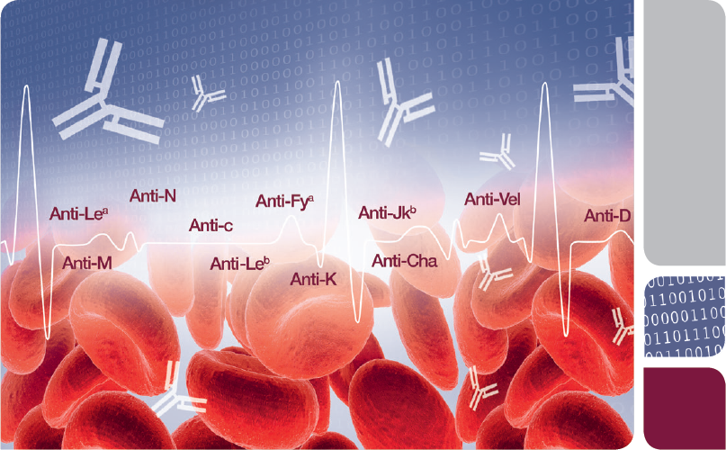

IH-A^{b}ID Integrated Antibody Identification
Prepared by
Paul Lamonby
International Product Manager, Software Solutions

Slide 20
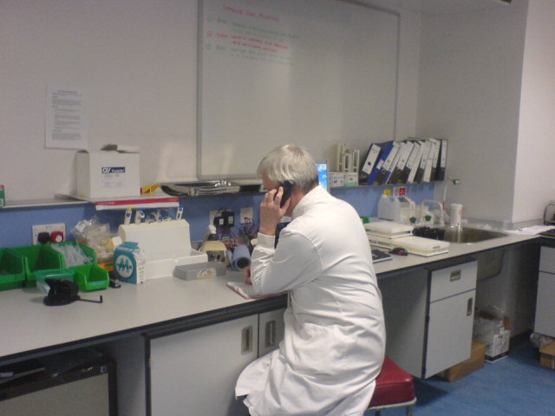




Software assisted A^{b}ID for….
  A Lab Technician……
    S.A: Software Assisted…..Good start. I’m going to need help
    R.B.C: Red Blood Cell…..Something for the Haematology Department
    A^{b}I.D: Antibody Identification……Certainly not for me

Slide 21


Software assisted A^{b}ID for….
  A Transfusion Scientist
    S.A: Software Assisted…..OK
    R.B.C: Red Blood Cell…..”They’re my babies…”
    A^{b}I.D: Antibody Identification……Is a form of art performed by special people who know what they are doing.
O
NEG

Slide 22
Managing expectations
Software can
Offer assistance
Structure work
Automate procedural steps
Software cannot
Replace knowledge or expertise

Slide 23
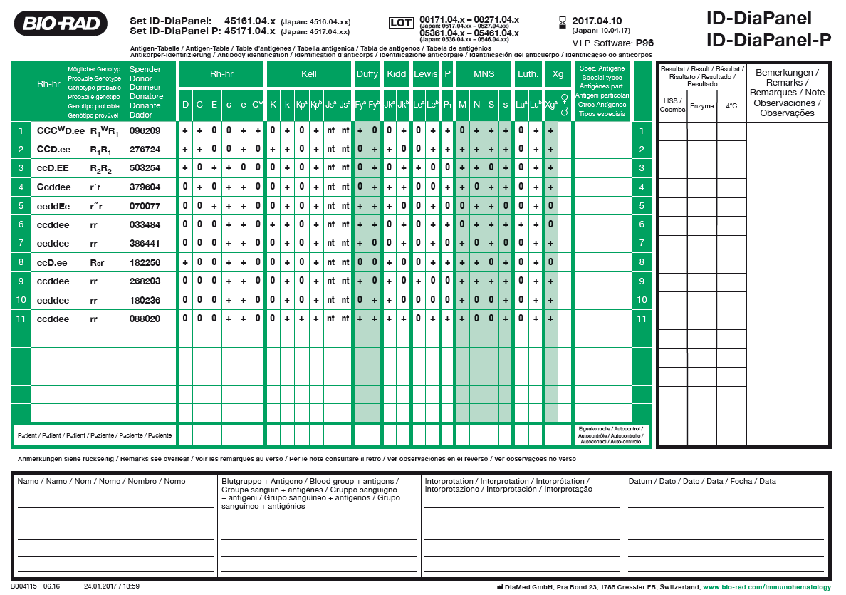
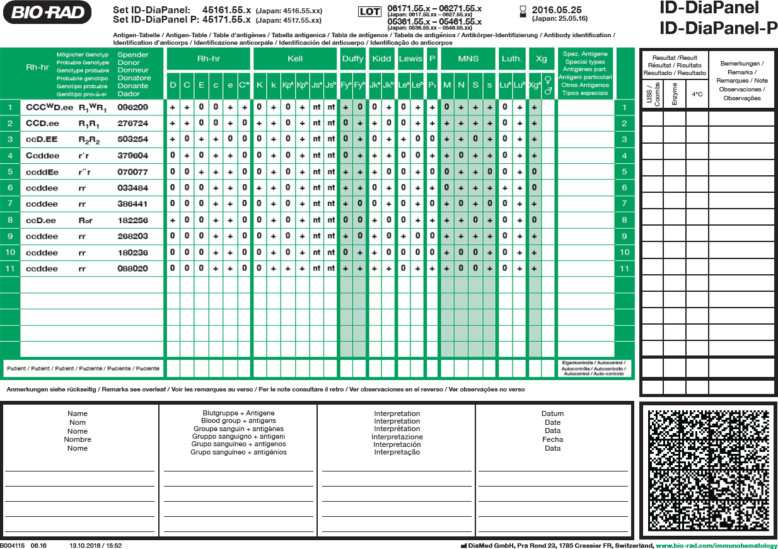

IH-A^{b}ID - Integration of panel information

Slide 24
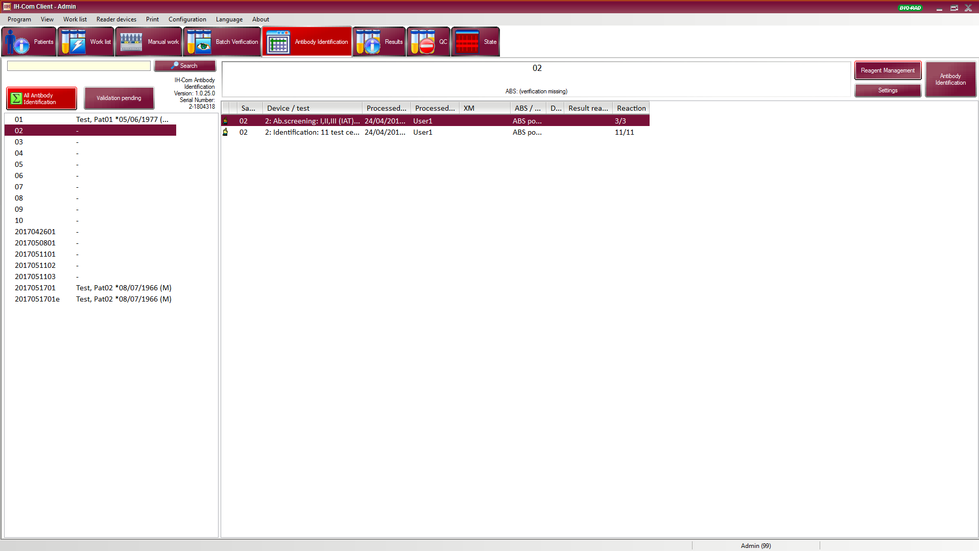
IH-A^{b}ID* - User Interface
New button in IH-Com
*Product in development

Slide 25
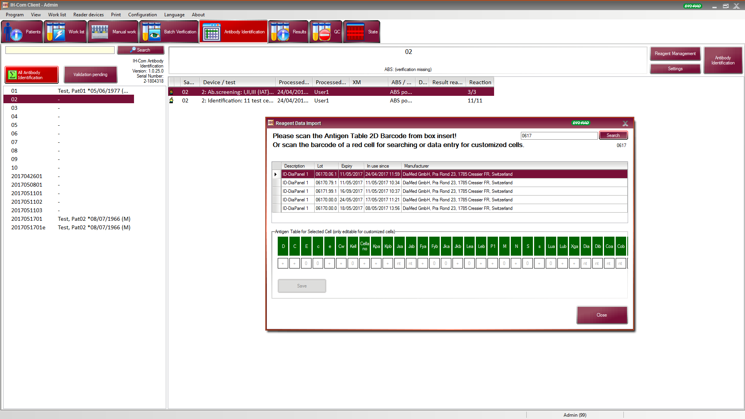
Scanning the 2D barcode will automatically import the complete Antigen Table

Slide 26
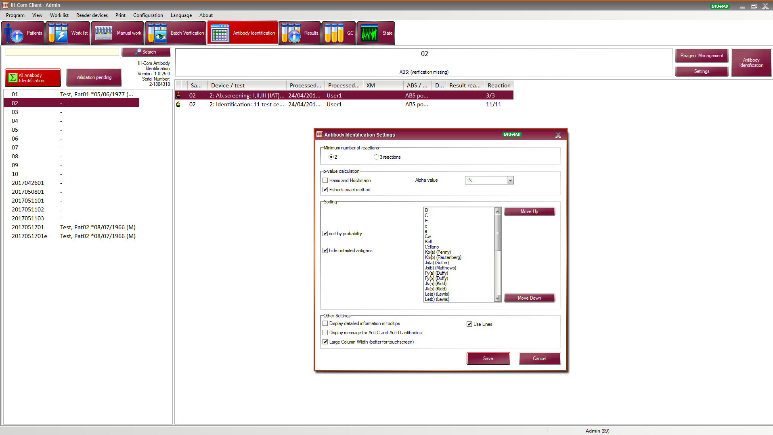
Exclude/confirm on 2 or 3 cells
Show statistics
Reshuffle Antigen Table columns
Hide unnecessary information
Lines or circles for crossing out
New button in IH-Com

Slide 27
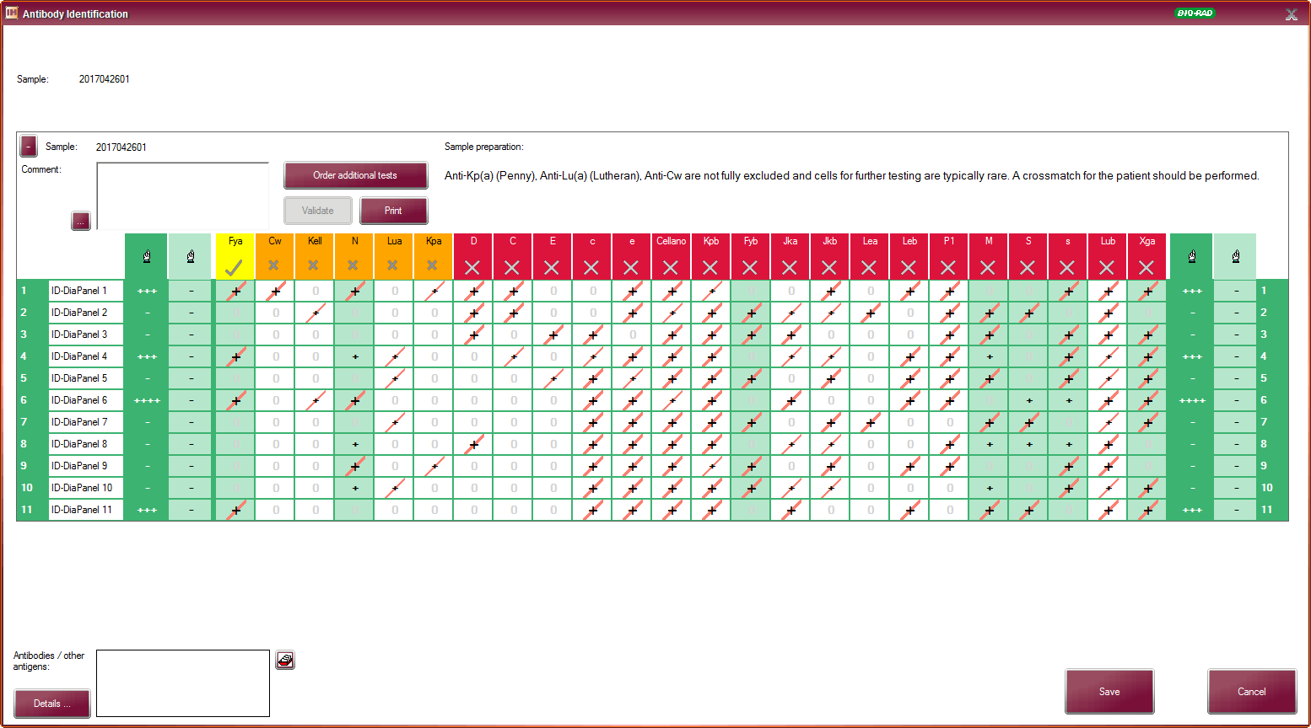
Most probable antibody
moved to the left
color changed to yellow
Antibodies not (fully) excluded
moved to the middle
color changed to orange
Antibodies ruled out
moved to the right
color changed to red

Slide 28
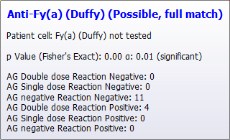
Mouse over yellow
Patient not phenotyped
p- value(s) if box ticked
Overview of exclusion rules used (number of cells)

Slide 29
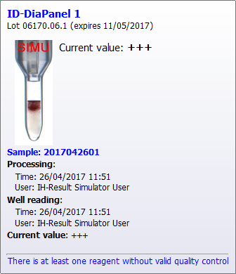
Mouse over reaction strength
Image of reaction in the the column from

Slide 30

Temporarily change results
«what if» scenario’s

Slide 31
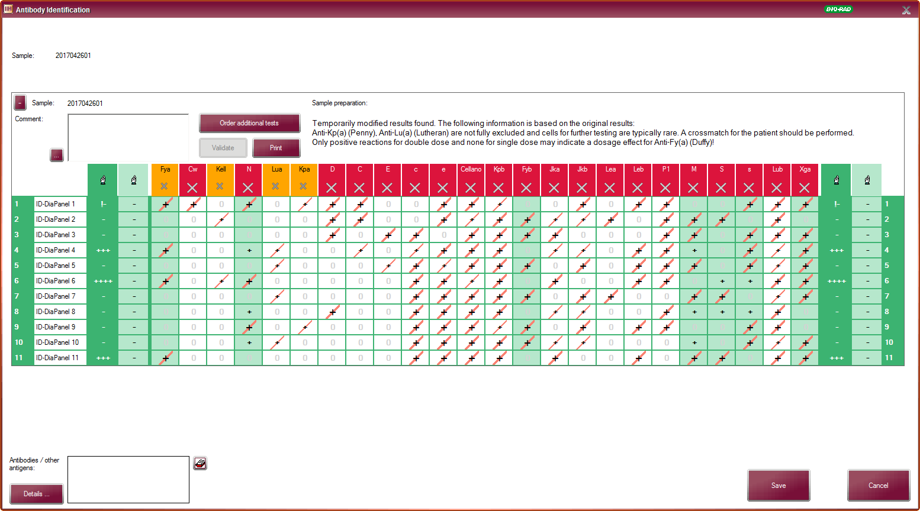
Results «what if» ?

Slide 32


Slide 34
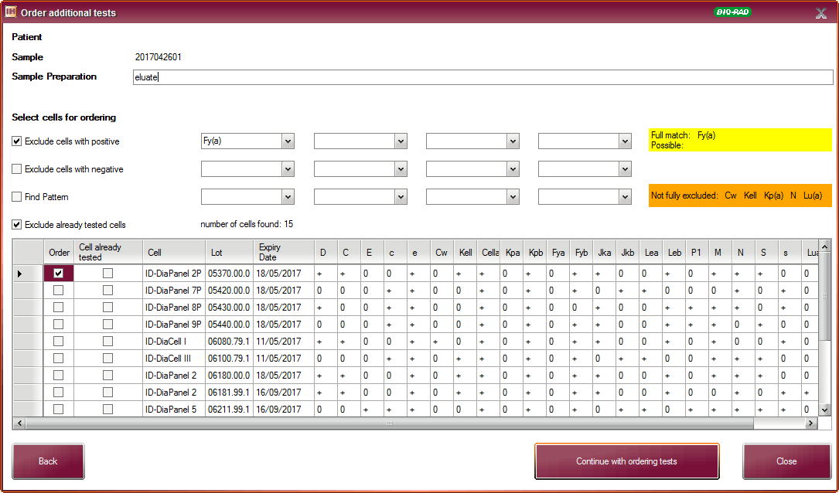
Screen to find additional cells for exclusion of antibodies in orange
Pick and order red cells to be tested
When processed, results will be added to the panel for further (re)interpretation

Slide 35
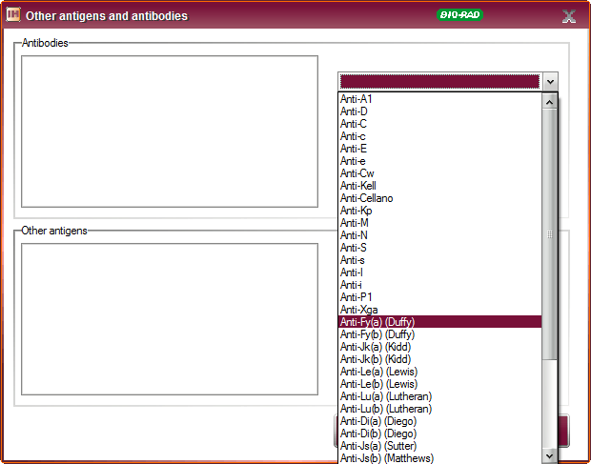
Field from IH-Com
Click on antibody identified

Slide 36
AbID SW: Main functions
  Bi-directional communication with IH-Com
  Import and display of antigen information
  Import and display of patient data and antibody identification results
  Graphical representation of antibody identification procedures
  Recommendations for further testing
  Reference guide for antigen facts
  Archive of data
  Automated search of inventory for reagent cells with specific antigen characteristics
  Print reports
  Include panel information for 3 production sites (Switzerland, Germany and Brazil)

Slide 37

Benefits
  Reduce hands-on time
  Eliminate opportunities for error
  Faster results for clinicians
  More efficient release of blood products
  Support less experienced/cross-trained staff

Slide 38
IH-A^{b}ID – How is it different from the rest?
  Panel information encoded in 2D barcode
    No internet connection required
  Fully integrated in IH-Com
    Centralised patient management
  Developed by experts
    Our customers

Slide 39

Last but not least

